Slide 1
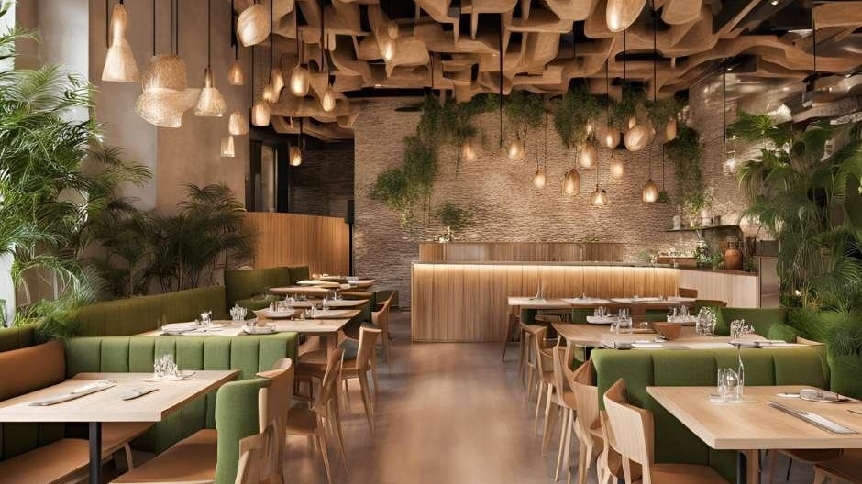
ECO-FRIENDLY STRATEGIES
Restaurant
Seat Management
A Sustainable Approach
Manasaa S K- 1CR25IS092
M V Shreya- 1CR25IS088
Keerthi S- 1CR25IS199
G Kushik- 1CR25IS060
Komala T G- 1CR25IS078
Lakshmi K L- 1CR25IS083
Discover how to harmonize profitability with environmental stewardship through intelligent seating strategies and eco-conscious design

Slide 2
Navigation
Journey Through
Sustainable Seating
01
The Art of Seating Optimization
02
Sustainable Materials & Design
Master table turnover, yield management, and strategic layout design for maximum efficiency
Explore eco-friendly materials, biophilic design, and energy efficiency for greener restaurants
03
Technology for Green Operations
04
Customer Experience & Sustainability
Leverage digital tools for smart seating and data-driven sustainability
Create memorable moments through eco-conscious hospitality and waste reduction
05
Measuring Success
Track key metrics and implement continuous improvement for lasting impact

Slide 3
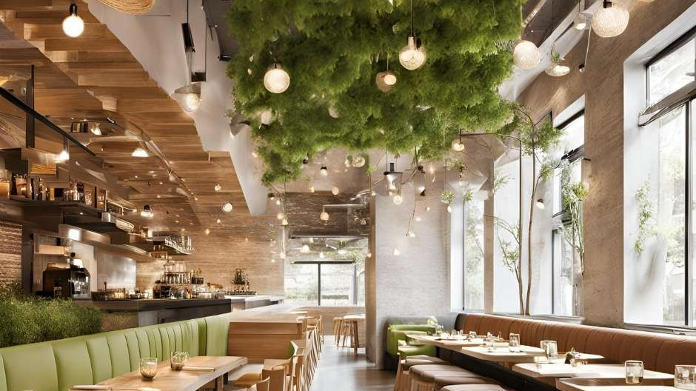
01
Chapter One
The Art of
Seating Optimization
Understanding the fundamentals of efficient restaurant seating and capacity management

Slide 4
Revenue Optimization
Table Turnover: The Heartbeat of Revenue
Mastering the delicate balance between efficiency and exceptional customer experience
The Fundamental Formula
The 30-Minute Rule
Table Turnover Rate
72%
18%
=
of diners leave after waiting 30 minutes
higher satisfaction with accurate wait estimates
Parties Served
÷
Research shows that managing expectations is as crucial as reducing actual wait times.
Available Tables
Optimization Strategies
Example: 45 parties ÷ 15 tables = 3 turnovers
Streamline reservations with real-time table management
Train staff for efficient service coordination
Industry Benchmarks
Simplify menus to reduce decision time
Casual Dining
3-4 turns
Fine Dining
1-2 turns
Quick Service
8-12 turns

Slide 5
Yield Management
Peak Time Mastery: High & Low Demand
Strategic pricing and availability management to maximize every service period
High Demand Strategies
Tier Reservation Availability
Table Size Optimization
Reserve prime slots for most valuable guests, open remaining tables closer to service
Block small parties from booking larger tables during peak periods
5-15%
Revenue Increase
Deposit Requirements
Minimum Spend
Implement cancellation fees to reduce no-shows and late cancellations
Set minimum requirements for premium tables or special events
Through strategic yield management implementation
Low Demand Tactics
Dynamic Pricing Impact
Flexible Policies
Special Promotions
Weekend Premium
+15-20%
Remove minimum spends, allow any party size to book available tables
Offer limited-time deals, happy hours, and menu specials
Holiday Pricing
+25-30%
Weekday Discounts
-10-15%

Slide 6
Space Optimization
Strategic Layout Design for Flow
Creating spaces that enhance customer comfort and operational efficiency
Seating Audit Process
Layout Principles
Utilization Metrics
1
Choose Peak Times
85%
Comfort & Accessibility
Audit during busiest periods: weekends and dinner service
Target table occupancy
Ensure ample space between tables and wheelchair accessibility
2
Observe Customer Flow
18-24"
Identify chokepoints and areas frequently avoided
Flexible Options
Minimum aisle width
Use modular seating for adjustable arrangements by group size
3
Evaluate Wait Times
3-4'
Measure seating delays and identify inefficiencies
Privacy Balance
Table spacing
4
Gather Feedback
Use dividers or planters to create intimacy without isolation
Use surveys to understand comfort and preference
Flexible Solutions
Staff Movement
Movable tables and chairs
5
Review Utilization
Track which tables remain unoccupied during peaks
Clear pathways for efficient service and reduced collisions
Extendable table leaves
Stackable seating

Slide 7
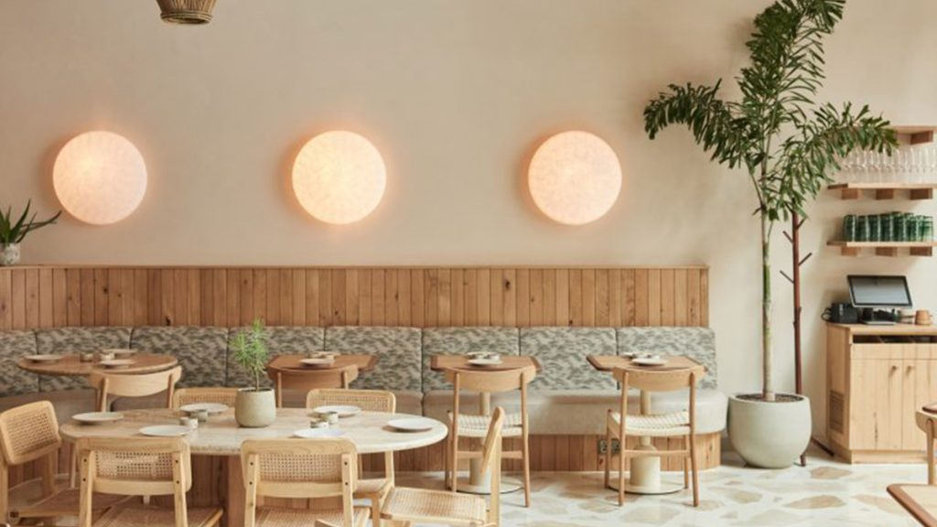
02
Chapter Two
Sustainable Materials
& Design
Exploring eco-friendly materials and biophilic design principles for restaurant spaces

Slide 8
Eco-Friendly Materials
Nature's Building Blocks: Sustainable Furniture
Durable, beautiful materials that respect the environment and enhance dining experiences
Bamboo
Cork
The renewable wonder: Technically a grass, bamboo offers hardwood durability with rapid renewability.
Harvested without harm: From tree bark, it allows trees to live for centuries, absorbing CO₂.
3-5 yrs
2x
to maturity
stronger than steel
Fire resistant
Acoustic benefits
Benefits: Pest resistant, humidity tolerant, ideal for high-traffic areas.
Applications: Flooring, wall panels, tabletops, and upholstery.
Reclaimed Wood
Recycled Metal
Stories in every grain: Salvaged from barns and factories, it reduces deforestation while adding character.
Industrial elegance: Adds contemporary edge while repurposing waste, ideal for outdoor use.
Environmental Impact: Prevents 5-10 tons of waste per project.
Benefits: Durable, weather-resistant, infinitely recyclable without quality loss.
Aesthetic Value: Nail holes and patina create unmatched character.

Slide 9
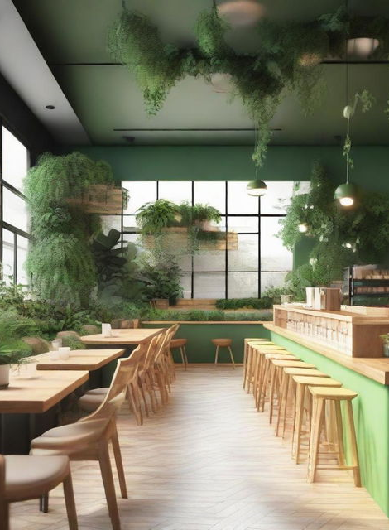
Biophilic Design
Where Nature Meets Dining
Integrating natural elements to enhance wellbeing and create memorable spaces
Indoor Greenery & Vertical Gardens
Plants purify air, improve acoustics, and create a sense of tranquility. Strategic placement can reduce perceived noise by 5-10 decibels.
Best Plants: Pothos, snake plants, ferns, herbs (dual purpose)
Natural Light
Water Features
Large windows reduce energy use and regulate circadian rhythms.
Fountains mask urban noise, creating serene environments.
Proven Benefits
15%
20%
12%
Stress reduction
Air quality improvement
Productivity boost

Slide 10
Green Technology
The Invisible Green
Cutting-edge technologies that reduce environmental impact while saving costs
LED Lighting
Smart HVAC
Energy Star
80%
10-15%
£1,500
Energy Reduction
Cost Reduction
Annual Savings
Lifespan: Up to 25x longer
Scheduling: Auto-adjusts
Refrigeration: Cuts use 30%
ROI: 2-3 years
Zoning: Cools only in use areas
Dishwashers: Reduce water
Savings: £500+ annually
1°C Reduction: Significant savings
Ovens: Faster preheating
Dimming: Enhances ambiance
Smart Sensors: Detect occupancy
Grills: Precise temperature
Combined Annual Savings
£5,000+
Full energy efficiency upgrade package
2-4 year payback

Slide 11
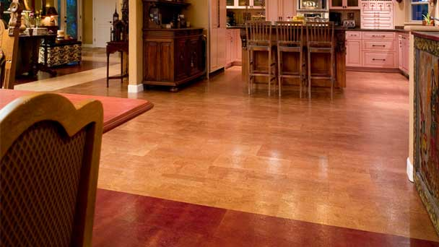
03
Chapter Three
Technology for
Green Operations
Leveraging digital solutions for sustainable and efficient seat management

Slide 12
Digital Innovation
Smart Seating: Digital Management
Modern reservation systems that optimize both efficiency and sustainability
Guest Communication
Automated Intelligence
Automated Confirmations
Reduces no-shows, provides details
10,000+
Real-Time Updates
Combinations analyzed per second
Table ready alerts, wait time updates
AI reviews seating arrangements to prevent server burnout and reduce wait times.
Feedback Collection
Post-visit surveys for insights
Real-Time Capabilities
Live Table Status: Instant updates when guests depart
Technology Investment Trend
Predictive Wait Times: AI provides accurate quotes
73%
Mobile Notifications: SMS updates for guests
of operators increased tech investment in 2024
Focus on efficiency, sustainability, and experience through digital transformation.

Slide 13
Analytics & Insights
Data-Driven Sustainability
Transforming information into actionable strategies for efficiency and waste reduction
POS Integration
Waste Reduction Impact
Modern POS systems track sales, inventory, and customer behavior, providing insights for smarter decisions.
4-10%
£1,000
Demand Forecasting: Predict customer traffic
Food waste reduction via inventory tracking
Savings per 3.3 lbs of waste reduced
Real-Time Reporting: Adjust staffing and inventory
Success Story: Manhatta's waste audit led to a new supplier strategy, cutting seafood waste by 62% and reducing food costs.
Customer Insights
CRM systems track preferences and visit frequency, enabling personalized marketing and service.
Result: Targeted campaigns encourage repeat visits and higher spending.
Performance Monitoring
Table Turnover
Real-time
Customer Satisfaction
Continuous
Energy Consumption
Live tracking

Slide 14
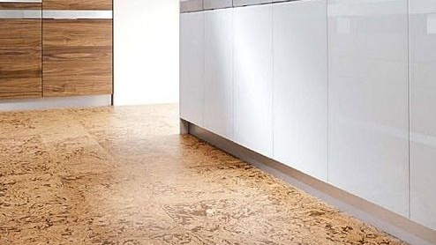
04
Chapter Four
Customer Experience
& Sustainability
Creating memorable dining experiences through eco-conscious practices

Slide 15
Customer Psychology
The Psychology of Green Hospitality
Understanding how sustainable practices and communication shape customer satisfaction
Sustainability Perception
Wait Time Psychology
90%
18%
of consumers say sustainability matters
Willing to pay 5-10% more for verified sustainable practices
Higher satisfaction with accurate wait estimates
Higher loyalty to restaurants that align with their values
More likely to recommend eco-conscious establishments
Transparency: Honest estimates empower guests
Communication: Regular updates build trust
Eco-Friendly Messaging
Managing Expectations
1
Use table tents to share sustainability story
2
Train staff to mention eco-practices naturally
Pre-Arrival Communication
3
Share waste reduction stats on social media
Post wait estimates on website and Google profile
Virtual Queue Options
Allow guests to explore nearby until table is ready

Slide 16
Circular Economy
From Farm to Fork to Soil
Implementing comprehensive waste management for environmental and financial benefits
Food Waste Audit
Composting Programs
Donation & Reuse
Begin with a comprehensive audit to understand your waste stream and identify opportunities.
Divert 30-60% of waste from landfills by composting organic materials into nutrient-rich soil.
Partner with food banks to donate surplus, addressing food insecurity while reducing waste.
Track & Categorize
On-Site Composting
Food Donation
Separate prep waste, spoilage, and plate waste
Requires space but offers maximum control and cost savings
Safe, prepared food to local shelters
Quantify Impact
Partner with Facilities
Animal Feed
Weigh and record waste for 1-2 weeks
Local composting services provide bins and scheduled pickups
Some waste can be used as animal feed
Identify Patterns
Staff Training
Creative Reuse
Analyze which menu items generate the most waste
Educate on proper sorting to avoid contamination
Use trimmings for stocks, stale bread for croutons
Financial Impact
4%
Environmental Benefit
30-60%
Manhatta case study results
Food cost reduction
Waste diverted from landfills
Through composting

Slide 17
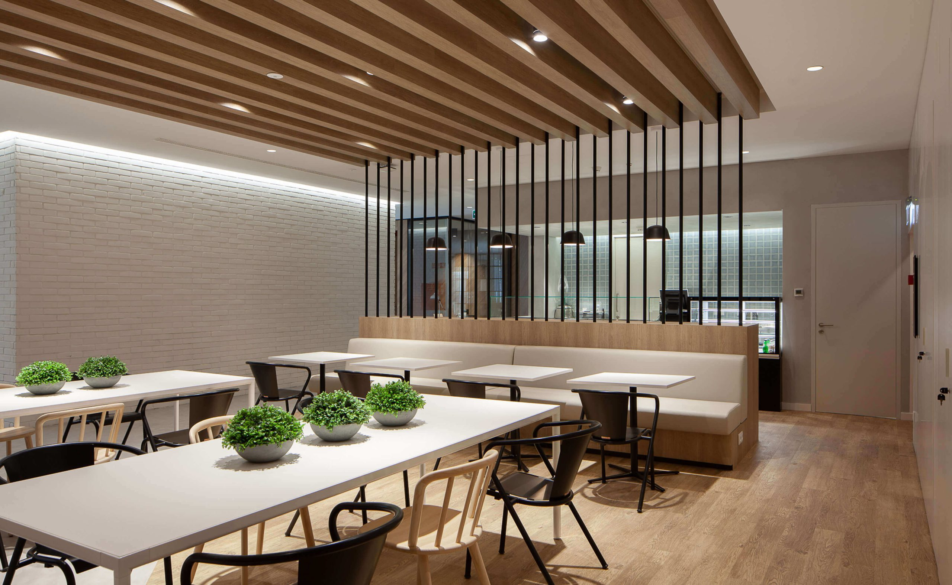
05
Chapter Five
Measuring
Success
Key metrics and continuous improvement for sustainable restaurant operations

Slide 18
Performance Tracking
Metrics that Matter: KPIs
Essential indicators for measuring operational and environmental performance
Operational Metrics
Sustainability Metrics
Experience Metrics
Table Turnover Rate
Food Cost %
Customer Satisfaction
Target: 3-4 (casual), 1-2 (fine dining)
Target: 28-32% of revenue
Target: 4.5+ stars, 85%+ recommend
Track during peak periods
Track weekly; aim for reduction
Monitor online reviews
Average Check Size
Waste Reduction Rate
Wait Time Satisfaction
Monitor trends and upselling success
Target: 30-60% diversion
Target: Under 20 min peak wait
Analyze by daypart and server
Measure composting & donations
Survey guests about experience
Customer Lifetime Value
Energy Consumption
Staff Productivity
Total value of repeat customers
Target: 10-15% reduction
Covers served per server hour
Drive with loyalty programs
Track kWh per cover monthly
Balance efficiency with service
Continuous Improvement
Monthly
Quarterly
Review metrics weekly, adjust strategies monthly
Performance review
Strategy adjustment

Slide 19

Cultivating Tomorrow's
Dining Experience
Sustainable seat management isn't just about filling tables—it's about creating harmony between profitability, customer satisfaction, and environmental stewardship.
Every efficient turn, every reclaimed wood table, every LED bulb contributes to a dining ecosystem that nurtures both business and planet.
Optimized Operations
Environmental Care
Enhanced Experience
Smart systems and strategic design maximize efficiency
Sustainable practices reduce impact and attract guests
Memorable moments that keep customers returning
Serve with Purpose

